Slide 1
AI vs Machine Learning vs Deep Learning

Slide 2
AI
“Artificial Intelligence is the broader umbrella under which Machine Learning and Deep Learning come. And you can also see in the diagram that even deep learning is a subset of Machine Learning. So all three of them AI, machine learning and deep learning are just the subsets of each other. So let us move on and understand how exactly they are different from each other”.

Slide 3
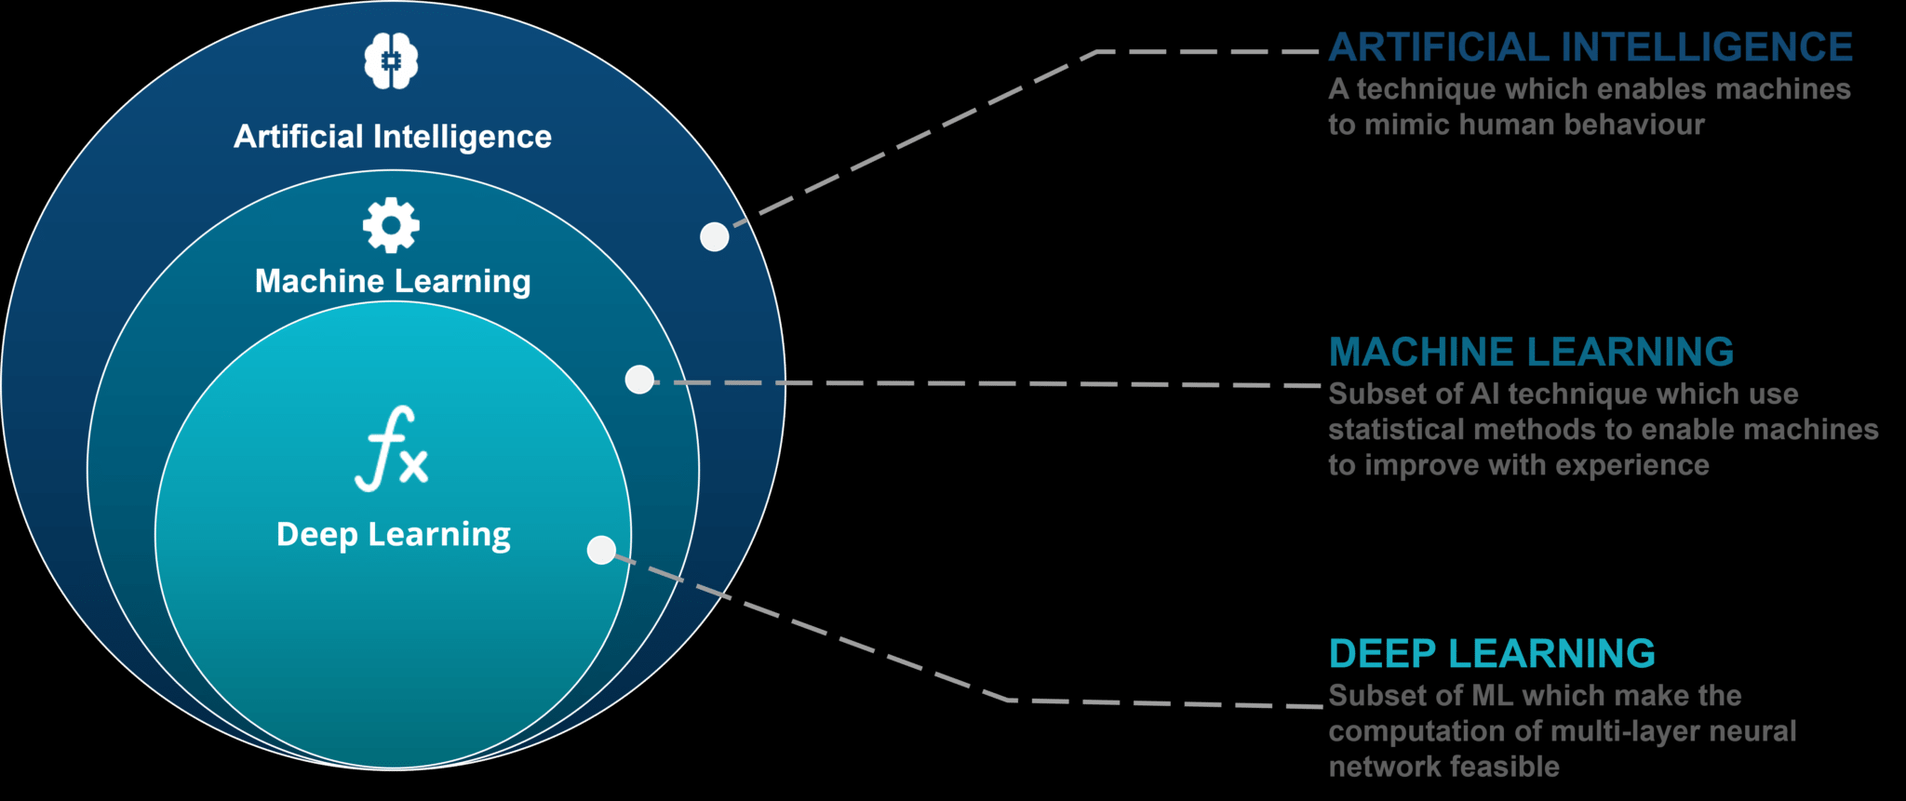

Slide 4
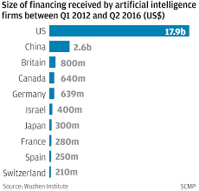
Starting with Artificial Intelligence
The term artificial intelligence was first coined in the year 1956, but AI has become more popular these days why? Well, it’s because of the tremendous increase in data volumes, advanced algorithms, and improvements in computing power and storage.
The data we had was not enough to predict the accurate result. But now there is a tremendous increase in the amount of data.
Now we even have more advanced algorithms and high end computing power and storage that can deal with such large amount of data.
As a result, it is expected that 70% of the enterprise will implement AI over the next 12 months, which is up from 40% in 2016 and 51% in 2017.

Slide 5
What is Artificial Intelligence?
Artificial Intelligence is a technique which allows the machines to act like humans by replicating their behaviour and nature.
Artificial Intelligence makes it possible for the machines to learn from their experience. The machines adjust their response based on new inputs thereby performing human-like tasks by processing large amounts of data and recognizing patterns in them.

Slide 6


AI

Slide 7


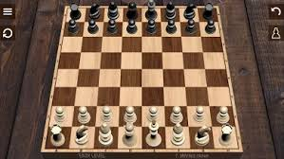
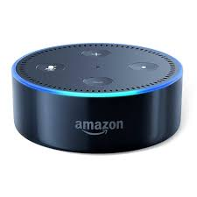
Examples

Slide 8
What is Machine Learning?
“Machine Learning is a subset of artificial intelligence. It allows the machines to learn and make predictions based on its experience(data)“

Slide 9
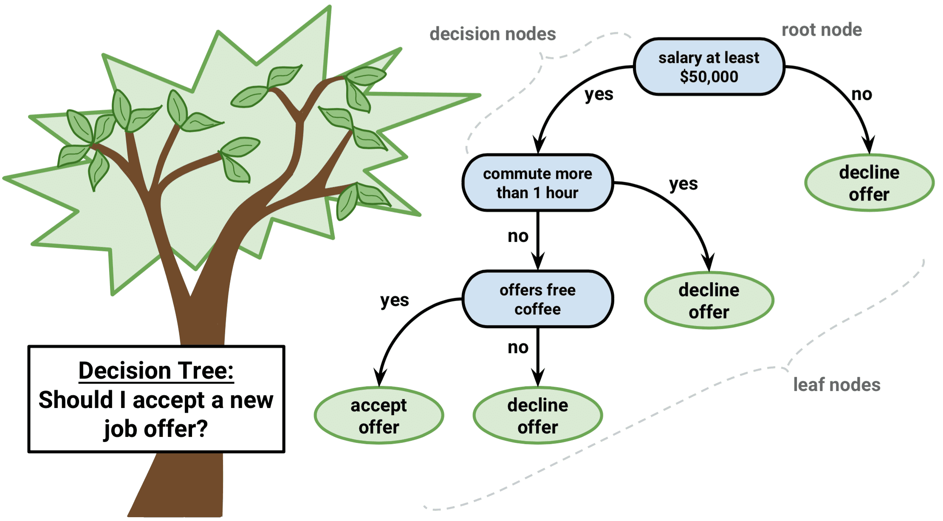
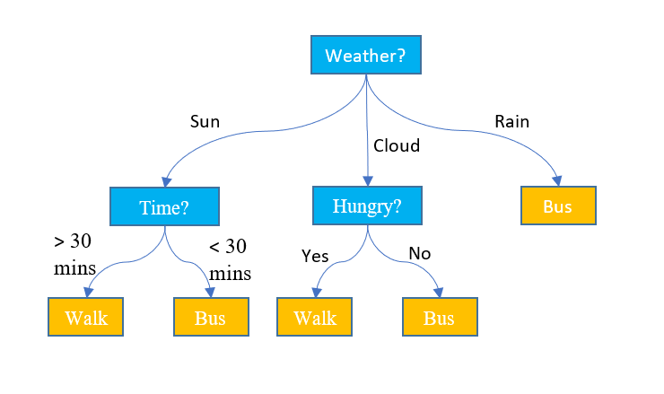
Examples

Slide 10
Deep learning
“Deep learning is a particular kind of machine learning that achieves great power and flexibility by learning to represent the world as nested hierarchy of concepts or abstraction”

Slide 11
Deep Learning Concept
The concept of deep learning is not new. But recently its hype has increased, and deep learning is getting more attention.
This field is a special kind of machine learning which is inspired by the functionality of our brain cells called artificial neural network.
It simply takes data connections between all artificial neurons and adjusts them according to the data pattern. More neurons are needed if the size of the data is large.
It automatically features learning at multiple levels of abstraction thereby allowing a system to learn complex functions mapping without depending on any specific algorithm

Slide 12
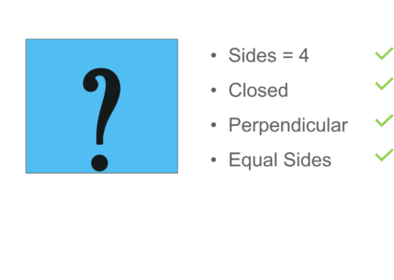
Examples

Slide 13
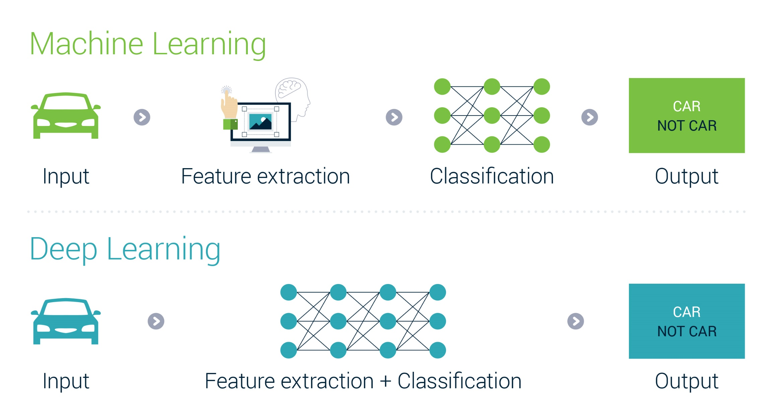

Slide 14
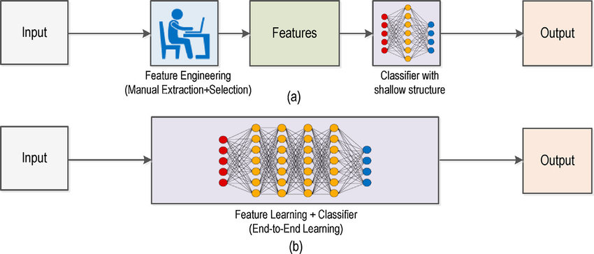

Slide 15
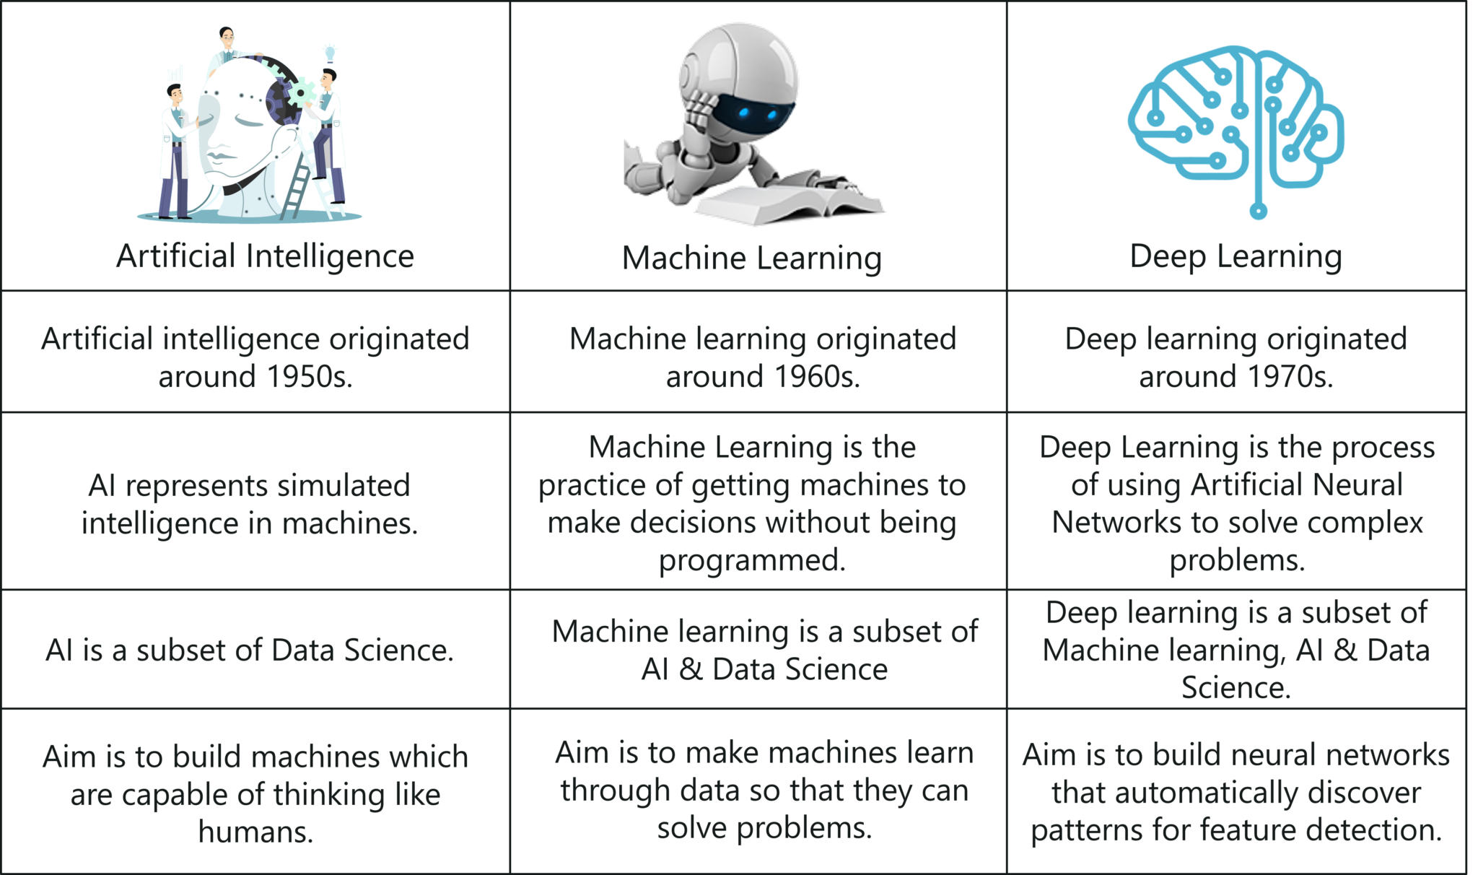

Slide 16
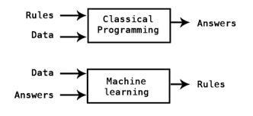

Slide 17
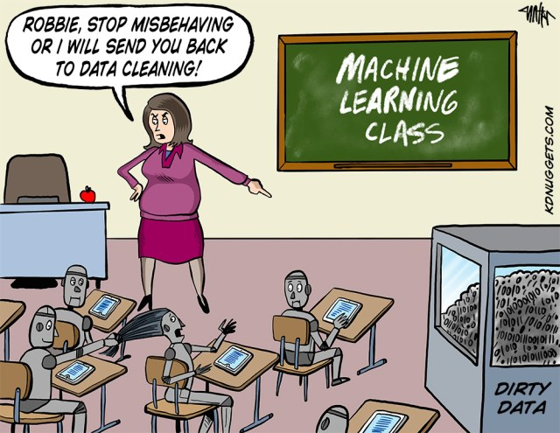

Slide 18
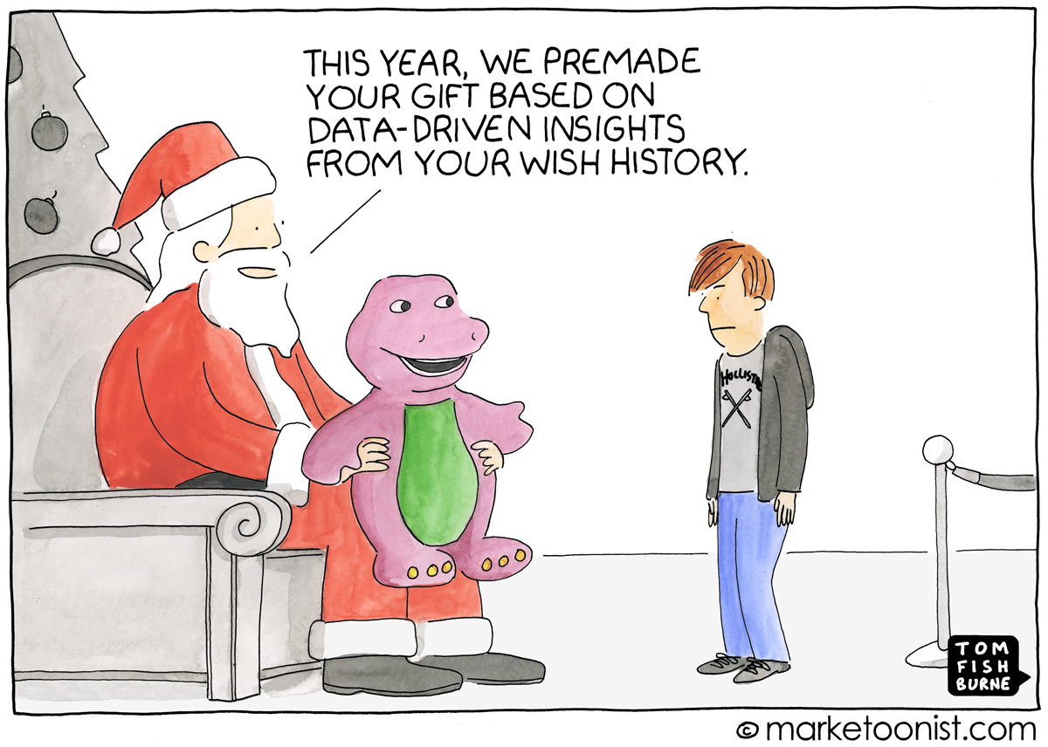

Slide 19
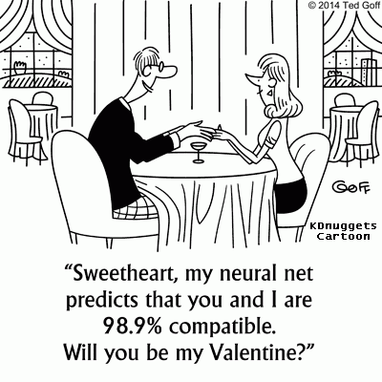

Slide 20


Slide 21
pip install opencv-contrib-python

